Slide 1
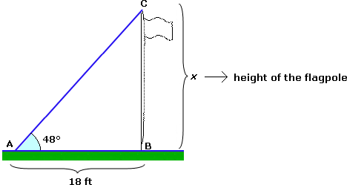
Focus Question – Angle of Elevation Problem
Winnie wants to know the height of the flagpole outside of her school. Use the given information to find this height.

Slide 2
Lesson Objective
To be able to find the area of a circle, or its radius or diameter if the area is provided. Also, to be able to find the area of a sector of a circle, or its degree measure, radius or diameter if the area of a sector is provided.

Slide 3
Geometry 11.5 – Areas of Circles and Sectors
Area of a Circle:
r

Slide 4
Practice Problems
Find the area or the diameter of the circles below. (Be exact - $π$ for $π$, round to tenths.)
$A=80 m^{2}$
9 ft.

Slide 5
Another Practice Problem
Find the area in terms of $π$.
40 yards

Slide 6
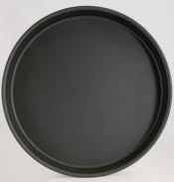
Application Problem
Amber wants to make a pizza in a pizza pan with a radius of 12 inches. When she makes this pizza, how much area will it cover?
12 in.

Slide 7
Sector of a Circle
What is a sector of a circle?

Slide 8
Area of a Sector
Area of sector $APB= \frac{m\hat{AB}}{360°}∙πr^{2}$
Note that a sector is a piece A
of the area of a circle.
P
B
r

Slide 9
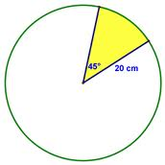
Practice Problems
Find the area of the sector or the missing radius. (Use 3.14 for $π$.)
Area of Sector = 88.49 sq. yd.

Slide 10
More Practice Problems
Use the given information to find the area of a sector of a circle. (Round answers to the nearest tenth.)
Radius of 13m and angle measure of $45°$ (Use 3.14 for $π$.)
Radius of 32in. and angle measure of $120°$ (Use $π$ for $π$.)
Diameter of 16yd. and angle measure of $40°$ (Solve in terms of $π$.)

Slide 11
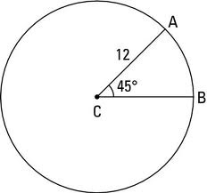
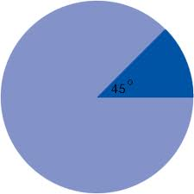
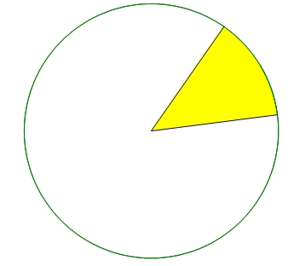
Even More Practice Problems
Find the area of the sector, the angle of the sector, or the radius. (Use 3.14 for $π$.)
8 cm
Area of sector = 113.49 $m^{2}$
Area of Sector = 22.33 ${cm}^{2}$

Slide 12
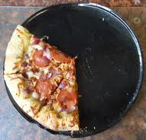
Application Problem
After some deliberation, Amber made her pizza in a pan with a radius of 9 inches. She then cut the pizza into 8 equally sized slices. Her friends and her ate 5 of the pizza slices. What is the area covered by the remaining pizza?

